Slide 1

MADO Presentation:
IMD Solutions Inc.
Ryan Stofer, Aashi Singh, Mina Yoon, Sophia Zhang

Slide 2
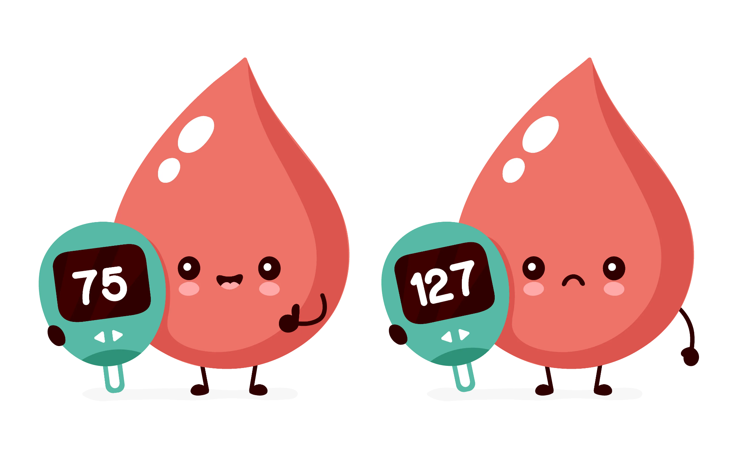
Background
- Product: Automated Glucose Delivery Device (GlucoGuard)
- Purpose: Monitors glucose levels for type 1 diabetes patients.
- Function: Administers glucose during nocturnal hypoglycemia.
- Predictive Model:
- Purpose: Prevents low blood sugar during sleep.
- Function: Predicts hypoglycemic events.
- User Application:
- Purpose: Provides a flexible UI for users.
- Function: Allows users to monitor glucose levels and receive alerts.
85
60

Slide 3
Project Overview
Data Processing
ML Modeling
Application Dev.
Integration

Slide 4
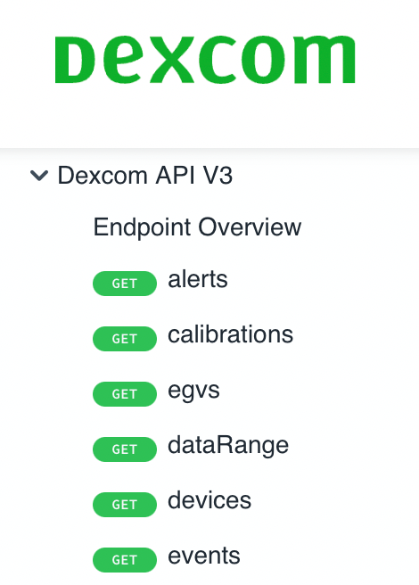
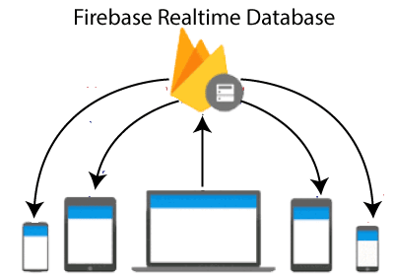
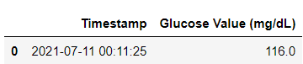
Data Processing
Data can be used by the rest of the app
Data Processing
Data Retrieval
Data Storage

Slide 5
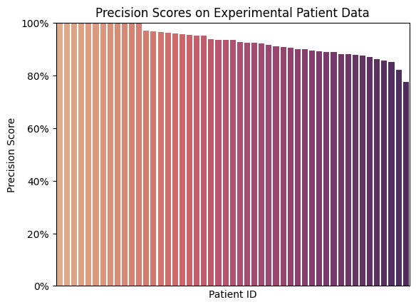

Prediction Modeling
Logistic Regression Model
Average Precision Score: 93.1%
Data

Slide 6
Application Design and Development

Slide 7
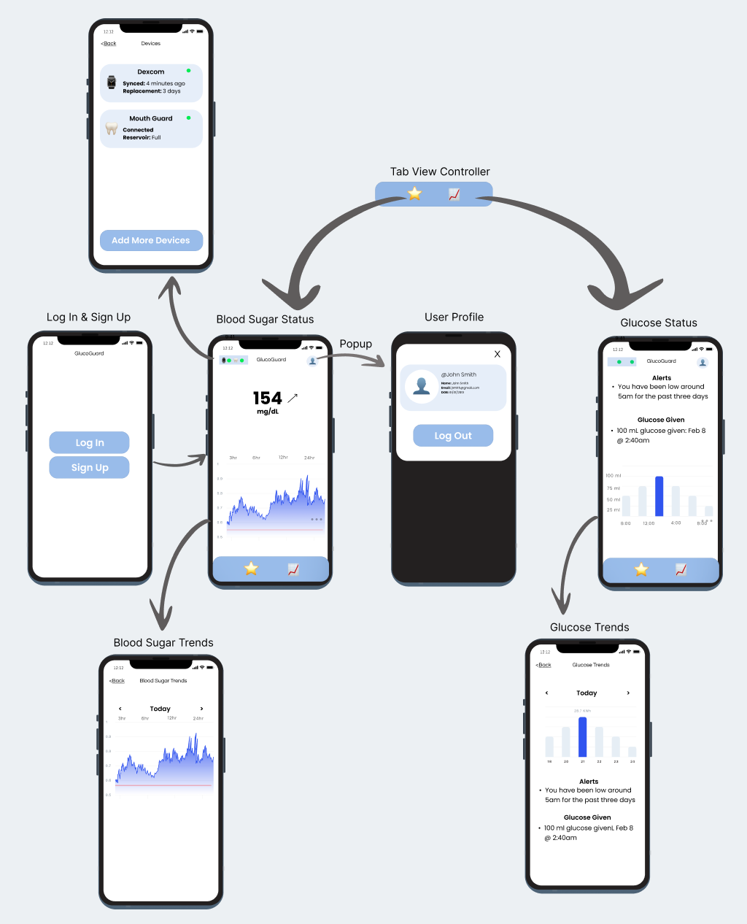
Design and
Initial Wireframe

Slide 8
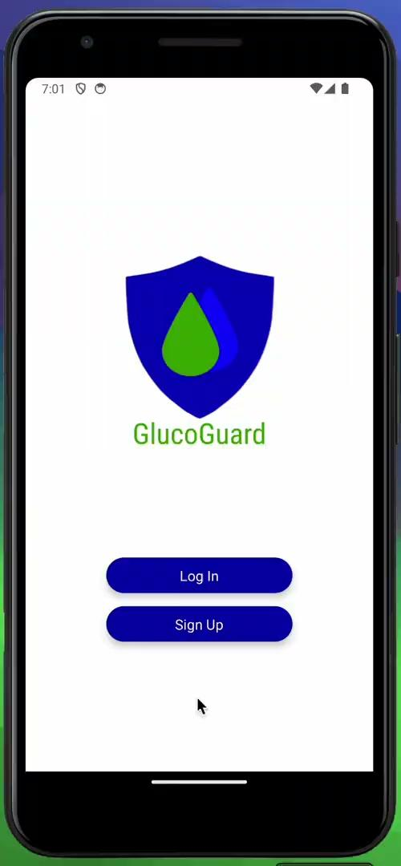
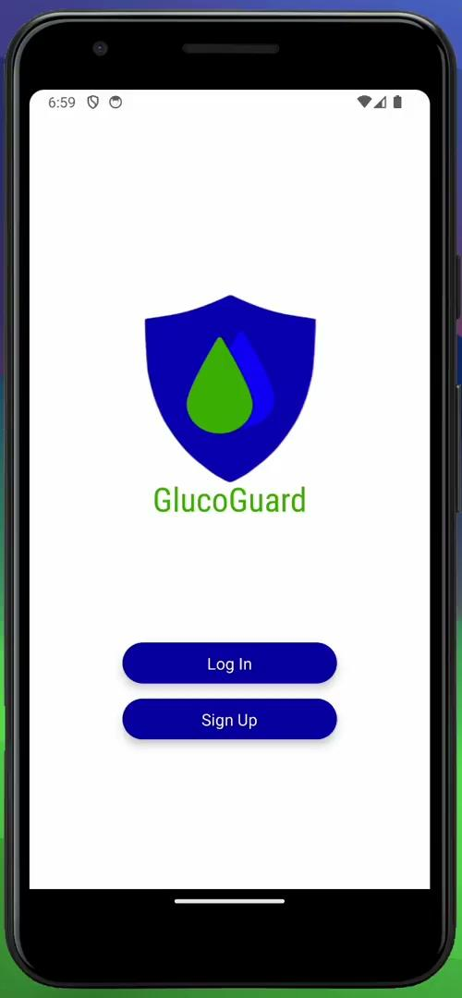
Login / Signup and Firebase Authentication

Slide 9
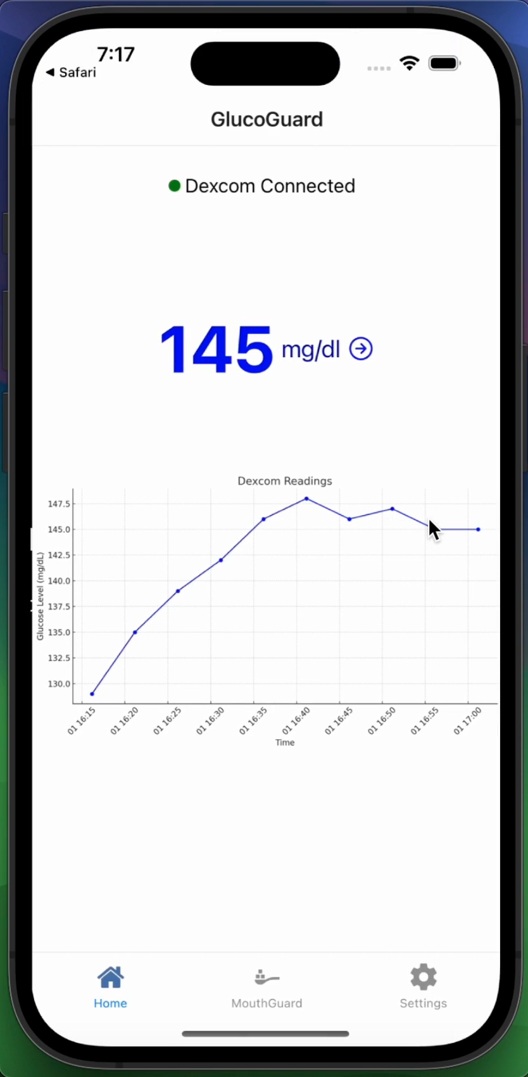
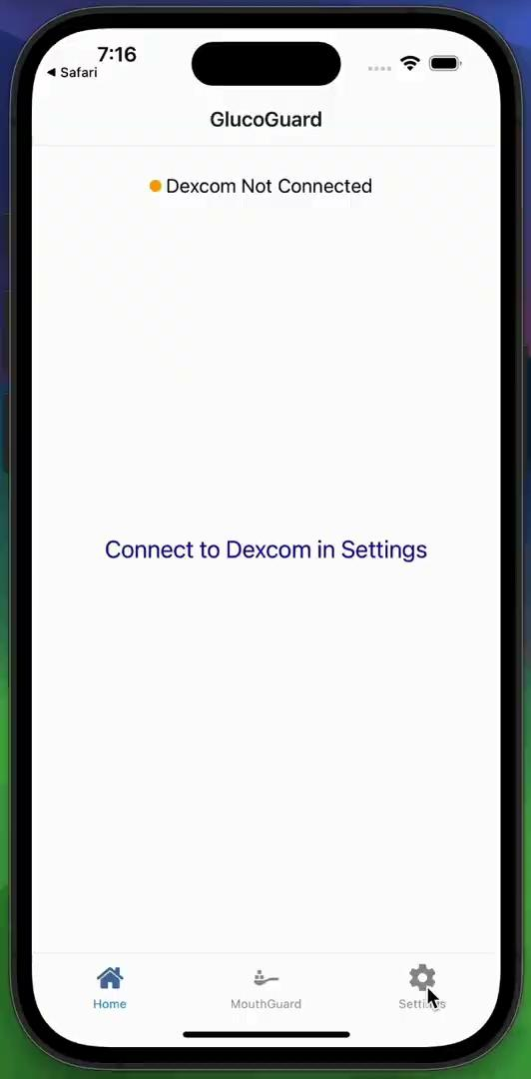
Dexcom API Integration

Slide 10
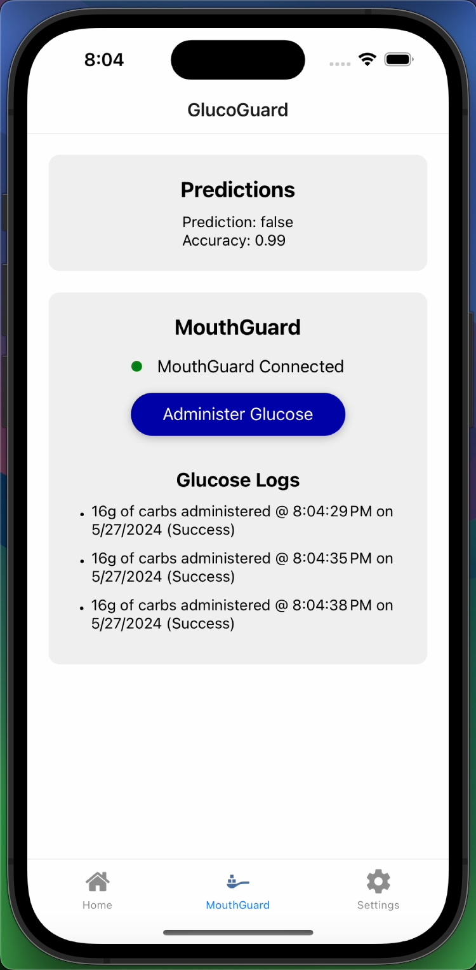
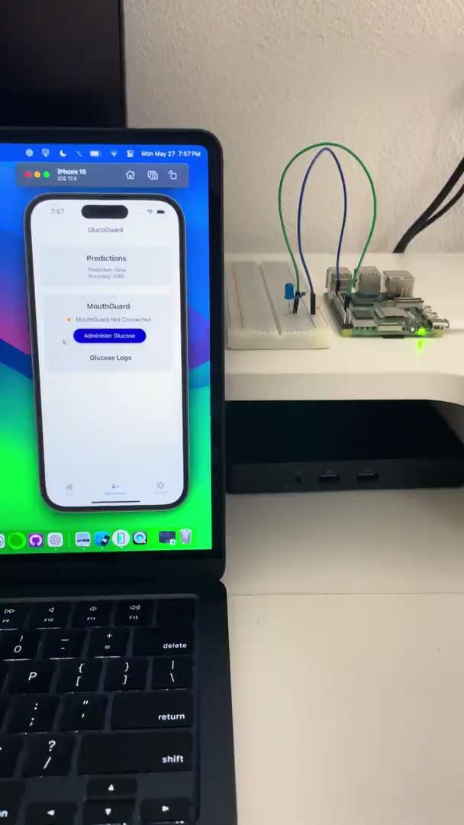
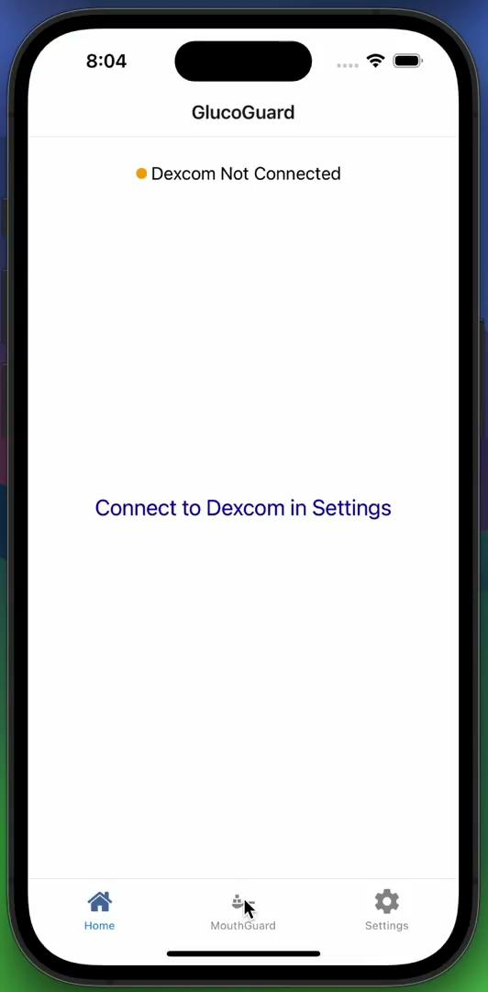
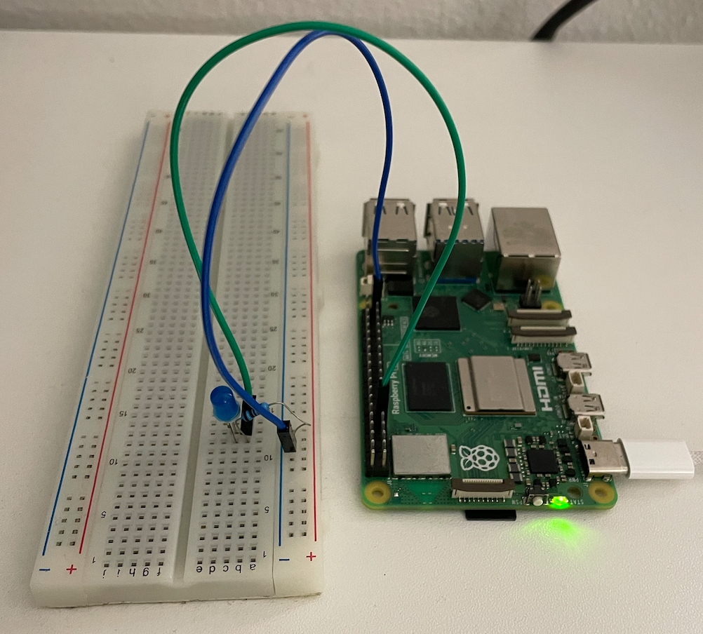
GlucoGuard Demo with Raspberry Pi

Slide 11
Integration
Backend
Service

Slide 12
Thank You

